Slide 1
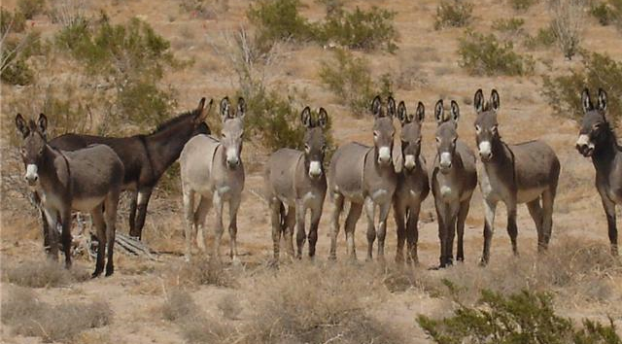

The People’s King – 1 Samuel 9

Slide 2
John 2:10 And saith unto him, Every man at the beginning doth set forth good wine; and when men have well drunk, then that which is worse: but thou hast kept the good wine until now.

Slide 3
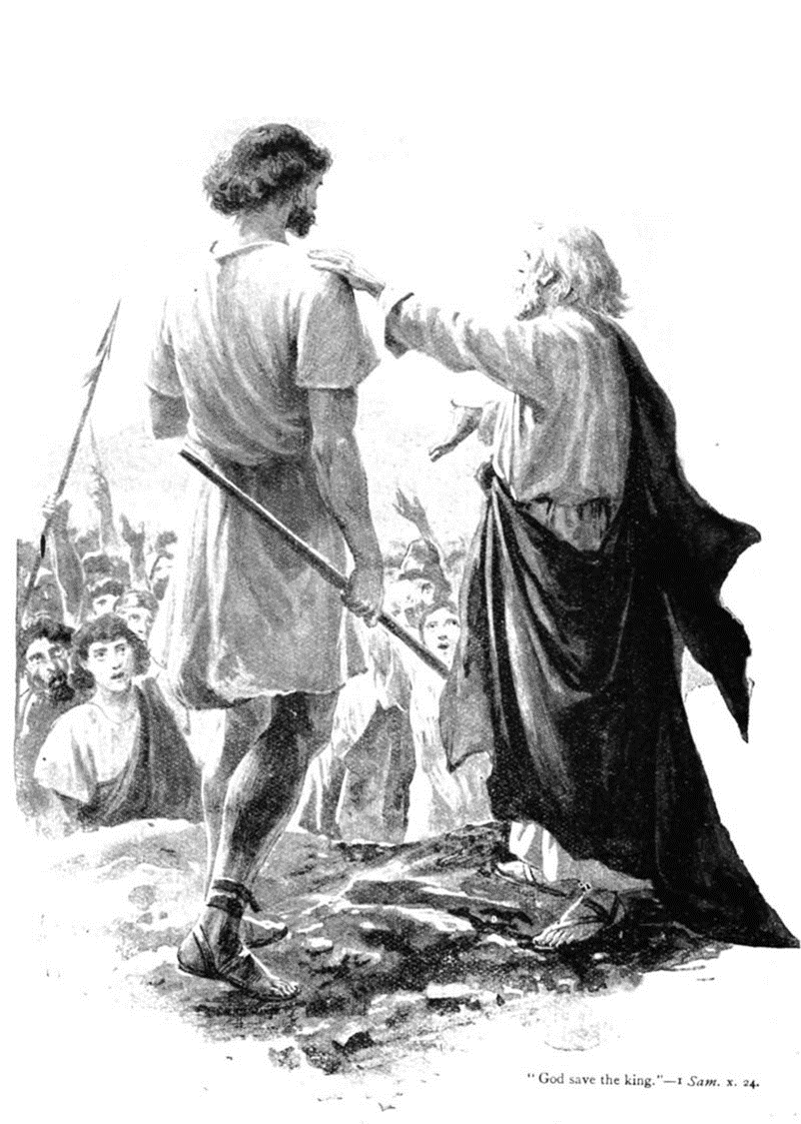
Saul’s Pedigree
Tribe of Benjamin.
Abi-el = My father is El (God)
Kish = “a bow” this comes from the word “Koshe” – to bend as in setting a trap.
Saul = asked; to request or demand. Interesting… “large and in charge!”
Saul had stature – he was from a leading family. His father was “a mighty man of power.”

Slide 4
2 Corinthians 11:14 And no marvel; for Satan himself is transformed into an angel of light.
Isaiah 14:12-15 How art thou fallen from heaven, O Lucifer, son of the morning! how art thou cut down to the ground, which didst weaken the nations! 13 For thou hast said in thine heart, I will ascend into heaven, I will exalt my throne above the stars of God: I will sit also upon the mount of the congregation, in the sides of the north: 14 I will ascend above the heights of the clouds; I will be like the most High. 15 Yet thou shalt be brought down to hell, to the sides of the pit.

Slide 5
Before this is over, Saul will rebel against the Word of God (which is as the sin of witchcraft
1 Sam 15:23) then seek after the murder of David and after ACTUAL witchcraft, then great loss, then suicide.

Slide 6
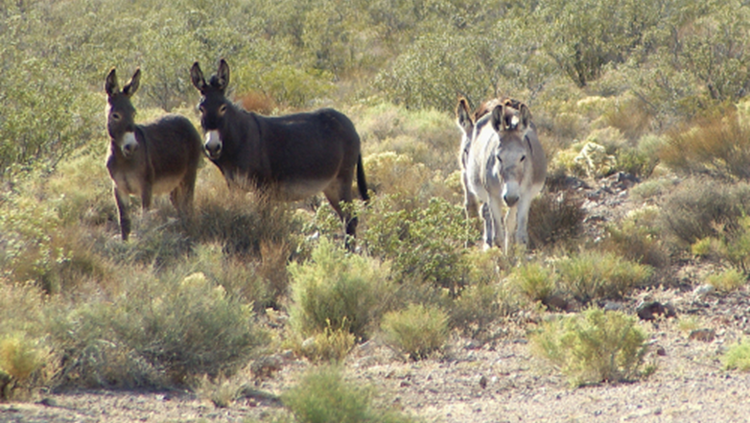
Saul’s Predicament.
Notice how Saul STARTS.
Saul shows care for his father.
God directs his steps!

Slide 7
Romans 8:28 And we know that all things work together for good to them that love God, to them who are the called according to his purpose.
Psalm 37:23 The steps of a good man are ordered by the LORD: and he delighteth in his way.
Psalm 119:133 Order my steps in thy word: and let not any iniquity have dominion over me.

Slide 8
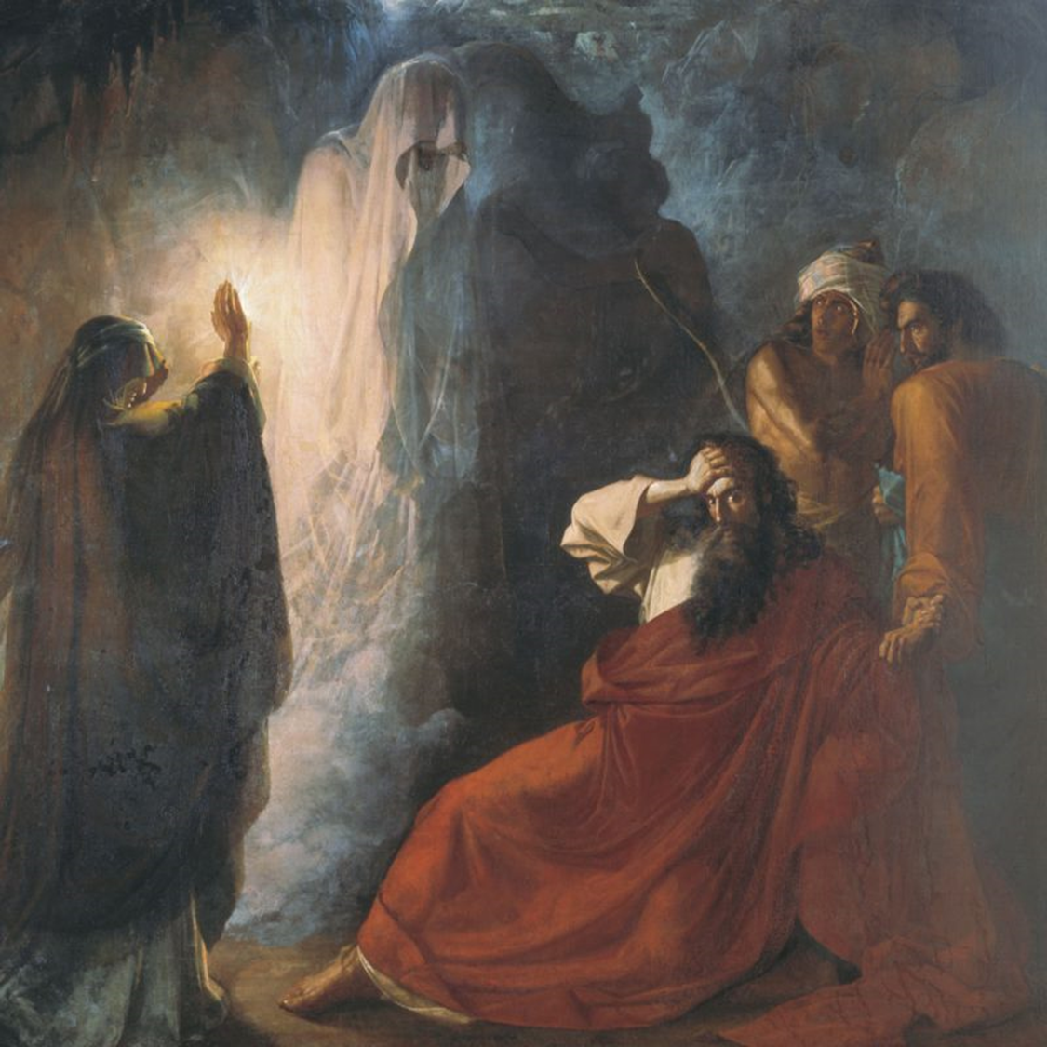
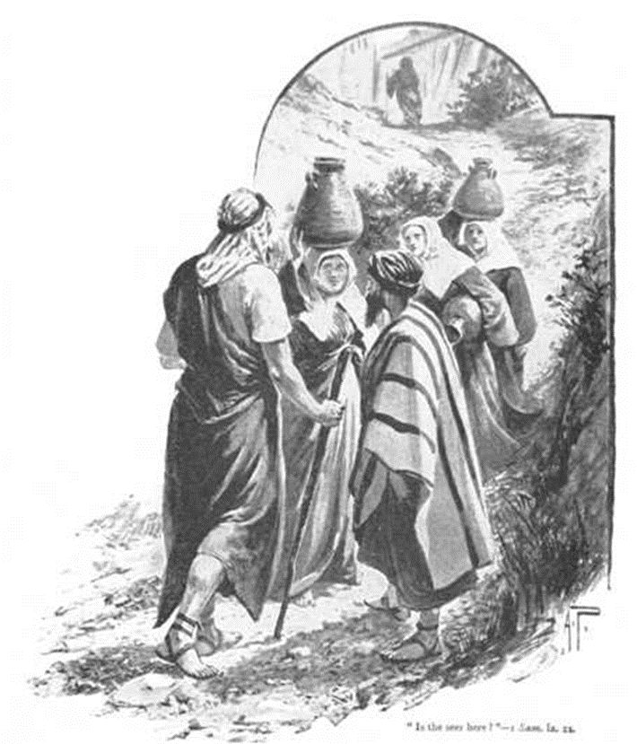
Saul seeks the man of God
Note: What is a Seer?
Vs 9 A Prophet!
Saul wanted a gift for the man/
work of God.
Saul is even willing to ask
women for directions!
Later, Saul asks another woman,
a witch, for directions!
1 Samuel 28:7-14

Slide 9
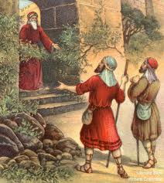
Saul’s Promise
Remember, this will be the king after Israel’s own heart.
God calls Saul a “captain” – that just means a leader. BUT, captains are men under authority.
Israel needs a king. What they are getting in Saul is sad!
Saul is so clueless, that he doesn’t even know WHO Samuel is – this is a bad sign, because REMEMBER what came into ALL Israel with Samuel’s ministry.

Slide 10
1 Samuel 3:19-21 And Samuel grew, and the LORD was with him, and did let none of his words fall to the ground. 20 And all Israel from Dan even to Beersheba knew that Samuel was established to be a prophet of the LORD. 21 And the LORD appeared again in Shiloh: for the LORD revealed himself to Samuel in Shiloh by the word of the LORD.
1 Samuel 4:1 And the word of Samuel came to all Israel. Now Israel went out against the Philistines to battle, and pitched beside Ebenezer: and the Philistines pitched in Aphek.

Slide 11
Problem: Saul’s focus is on himself.
Vs 19b “I… will tell thee all that is in thine heart.”
When we don’t seek to know and submit to the Word of God, we seek to study how to fulfill the desires of our own heart.
Proverbs 18:1-2 Through desire a man, having separated himself, seeketh and intermeddleth with all wisdom. 2 A fool hath no delight in understanding, but that his heart may discover itself.

Slide 12
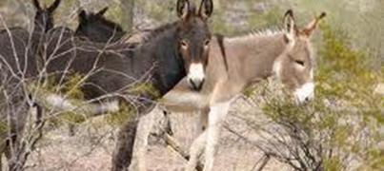
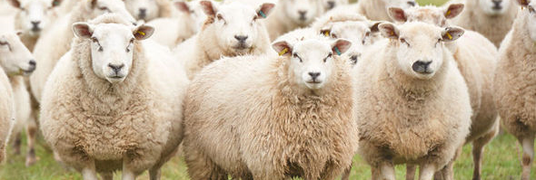
Saul is associated with the search for asses.
David is associated with protecting sheep.
Psalm 78:70-72 He chose David also his servant, and took him from the sheepfolds: 71 From following the ewes great with young he brought him to feed Jacob his people, and Israel his inheritance. 72 So he
fed them according to the
integrity of his heart; and
guided them by the
skilfulness of his hands.

Slide 13
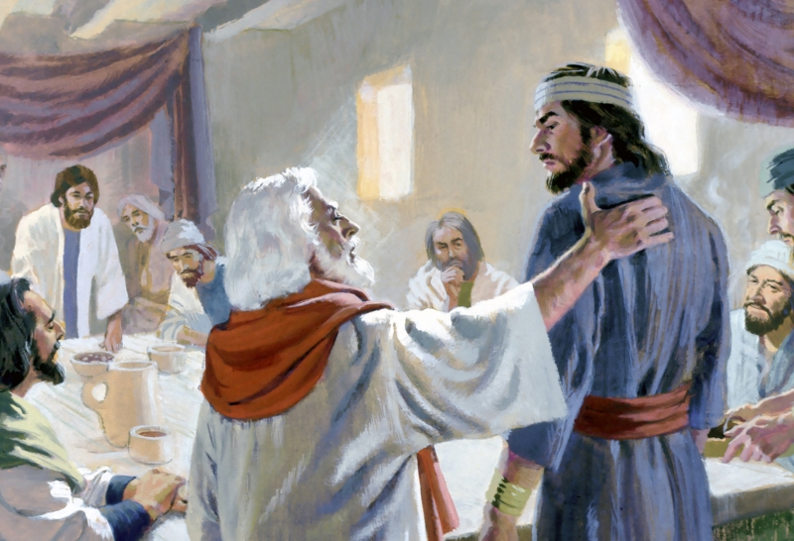

Slide 14
You can start good and end evil.
John 2:10 And saith unto him, Every man at the beginning doth set forth good wine; and when men have well drunk, then that which is worse: but thou hast kept the good wine until now.

Slide 15
2 Thessalonians 2:3-4 Let no man deceive you by any means: for that day shall not come, except there come a falling away first, and that man of sin be revealed, the son of perdition; 4 Who opposeth and exalteth himself above all that is called God, or that is worshipped; so that he as God sitteth in the temple of God, shewing himself that he is God.

Slide 16
Philippians 2:12 Wherefore, my beloved, as ye have always obeyed, not as in my presence only, but now much more in my absence, work out your own salvation with fear and trembling.

